Slide 1
Retirement explainer #6:
Pathways to retirement solutions
David Bell – The Conexus Institute
Geoff Warren – The Conexus Institute and ANU

Slide 2
Overview
We investigate various pathways through which retiring or retired members might be directed towards suitable retirement solutions
Our organising structure is who identifies the solution, considering three parties:
  (1) Member (2) Adviser, or (3) Trustee
For each pathway, we outline
  Nature of the pathway
  Strengths and opportunities
  Weaknesses and challenges
  What is required for the pathway to work effectively
We then discuss implications of the Delivering Better Financial Outcome (DBFO) reforms

Slide 3
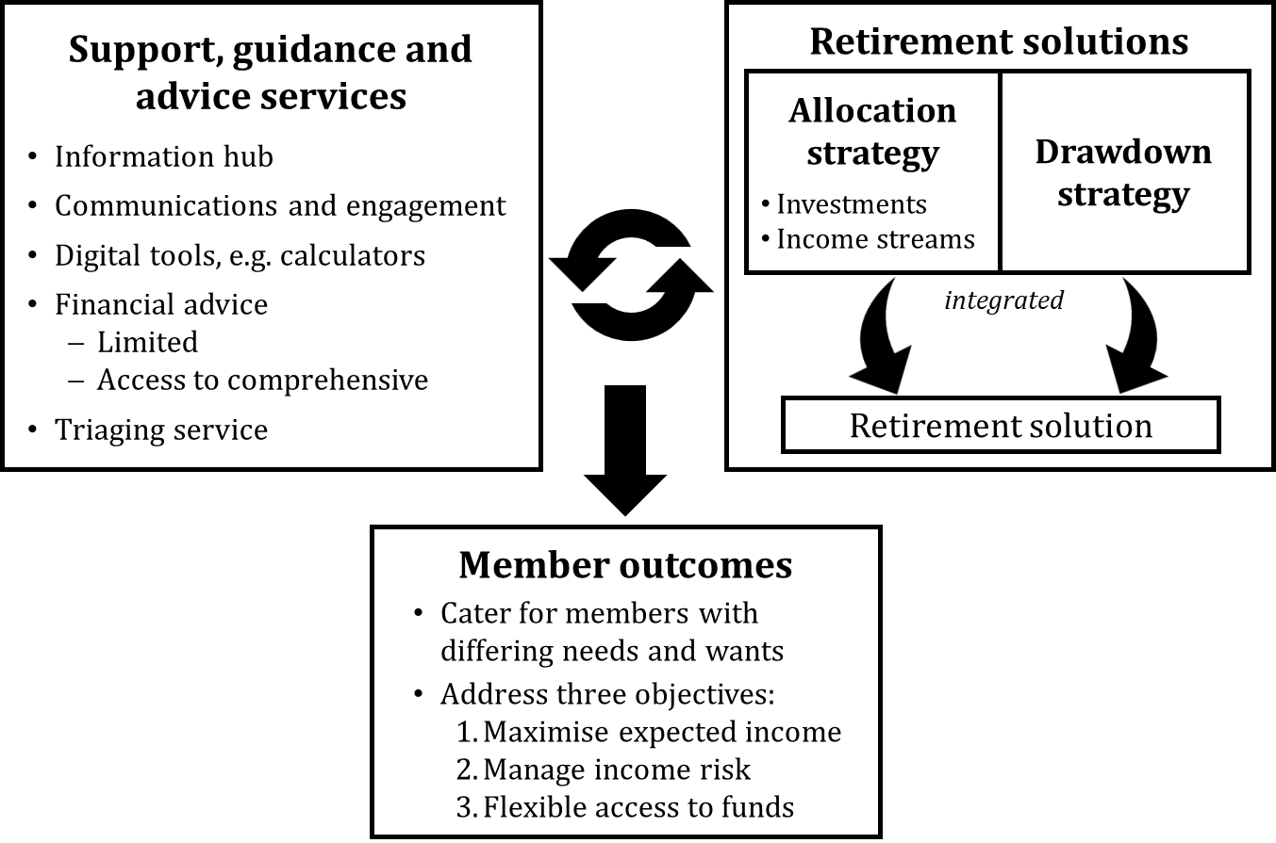
Retirement income strategies vs. solutions
How can retired members find their way to a suitable solution?

Slide 4
Five pathways to retirement solutions
Pathway | Self-direction | Adviser direction | Trustee direction
 | Member choice | Personal financial advice | Trustee recommendation | Trustee assignment | Default
Main features | Member chooses solution, drawing on decision support services | Member is directed to a solution by a financial planner through: (a) limited advice, or (b) comprehensive advice | Trustee recommends a solution to member, who then opts-in or opts-out | Member requests trustee to assign them to a solution | Trustee defaults member into a (probably basic) retirement solution
Member type most suited for | Members who want to choose for themselves | Members who desire a personalised recommendation and are willing to pay | Members looking for direction, but: Do not want to seek a financial adviser Not well-prepared to choose for themselves |  | Highly disengaged members who take no action
Currently accommodated
Potentially facilitated under DBFO phase 2 (‘advice through super’)
No current plans to facilitate
Pathways are based on who is primarily responsible for identifying a solution, but many grey areas

Slide 5
All pathways have a role to play
Members differ in how they want to engage with retirement decisions
Trustee direction is the missing link:
  About 70% of members not taking advice and don’t want to choose
  Some want and expect their fund to look after them
Members may be better off in some pathways than others
DISCUSSION
Does your membership profile look something like this?

Slide 6
Member engagement process
Trustee attempts to triage
Either collects personal information and/or ‘shepherds’ the member
Solution identified (possibly cohort-based); offered with opt-out
Follow-ups … ideally
Please choose one of the following options:
1. Please assign me to a retirement solution | ○
2. Recommend a retirement solution to me | ○
3. Please refer me to a financial planner | ○
4. I want to choose a retirement solution for myself | ○

Slide 7
Summary – Main opportunities and key challenges
DISCUSSION
Any (major) challenges that are missing?
7

Slide 8
DBFO phase 2 proposed reforms may adjust the picture
‘Advice through superannuation’ reforms aim to define the scope of advice that trustees may provide on a collectively-charged basis. Key elements include:
  Advice must relate to the member’s interest with the fund
  Allowed/disallowed topics, as well as allowed circumstances that may be taken into account, to be defined under regulations (see next slide)
Targeted prompts (i.e. ‘activity nudges’) to be permitted, subject to a range of requirements around establishing and monitoring their suitability for members
Implications:
  Advice through super reforms appear to pave the way for trustee recommendations
    They should also make it clearer when referring members a financial adviser is appropriate
  A ‘safe space’ for nudges is carved out, but requirements seem somewhat onerous
  Role of the ‘new class of adviser’ needs to be specified to complete the picture
DISCUSSION
How likely are trustees to make use of these capabilities?
8

Slide 9
Proposed scope of trustee-provided retirement advice
Extracts from Treasury’s Advice through Superannuation discussion paper
Status | Allowed topics | Allowed circumstances | Disallowed topics
Currently proposed by Treasury | Super contributions Investment options Insurance through super Retirement income Examples: Transition to retirement products Retirement income solutions and products Drawdown strategies Lump sum withdrawals Longevity protection | Cash flow and income of member’s household Assets and interests held outside of super by member’s household Examples: Property Cash Insurance Securities Financial position of the member’s spouse Debts and liabilities of a member’s household Eligibility for government services Examples: Age Pension Other support | Purchase or disposal of assets outside of super Purchase or disposal of financial products outside of super Holistic financial planning Estate and tax planning
Missing key characteristics, with reference to Explainer #4 |  | Member objectives and preferences Examples: Investment risk tolerance Type of retirement income stream Income risk tolerance Requirement for accessible funds
DISCUSSION
Thoughts on these lists?
9

Slide 10
Guidance and advice landscape after DBFO phase 2
Paid personal financial advice | Member self-direction | Targeted prompts (‘activity nudges’) | Personas | Trustee recommendation
Available on paid basis, particularly for members with more complex circumstances. Trustees to refer members where appropriate. | Available for members who prefer to choose for themselves. | Limited in scope. A member response and potentially self-direction is required. | Allows member to self-identify with a cohort for which there is a recommended retirement solution. | Facilitated under intra-fund advice, with scope of allowable advice and personal information defined under regulations.
 | Trustee-provided guidance services Triaging service, information hub, digital tools, general advice, etc
DISCUSSION
Should trustees be looking to offer the full range of guidance and advice services?
10

Slide 11
Our own reflections
Members differ in how they engage with retirement decisions.
This creates a need to provide a comprehensive range of pathways.
DBFO phase 2 reforms offer potential to be a ‘game-changer’ for the capacity of super funds to provide affordable financial advice at scale, and provide all members with at least some advice.
How the industry evolves in response to these reforms will be interesting. We are yet to be convinced that super funds will make full use of the reforms to provide trustee recommendations of retirement solutions or provide activity nudges.
11
11

Slide 12
Thank-you!
Further questions, discussion or feedback?
Wrapping up …
For research paper, see:
Conexus Institute website: https://theconexusinstitute.org.au/
Direct link: Pathways-to-retirement-income-solutions-Draft-for-Discussion-Final-20230911.pdf (theconexusinstitute.org.au)
12

