Slide 1
The need for a retirement licensing regime
David Bell
Executive Director, The Conexus Institute
IBR Post Retirement Conference, 22 October 2024

Slide 2
Outline
Current state
Six challenges to overcome
How a retirement licensing regime (RLR) would work
How a RLR would help to overcome the challenges
Feedback thus far
Next steps

Slide 3



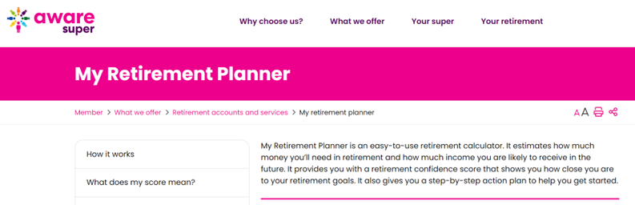

Current state
Signs of positive momentum in the retirement phase of super
Some examples of leadership:

Slide 4
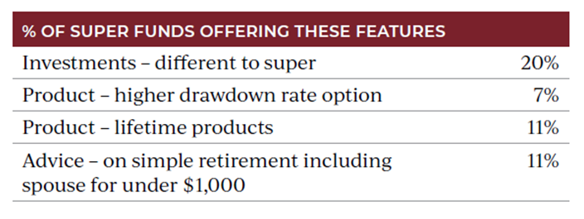
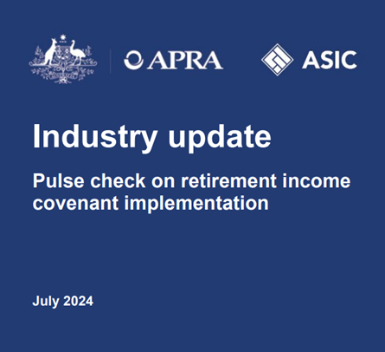

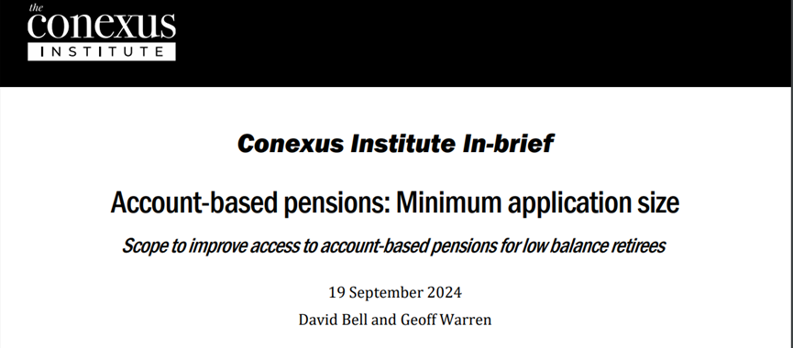
Current state
Through a member lens progress is slow
Dispersion in progress across funds
Source: Ian Fryer, Chant West, for Retirement Magazine

Slide 5
Six challenges to overcome
1. Market forces won’t drive progress
4. Policy and regulatory uncertainties
2. Catering for diverse member needs
5. Role of funds in closing advice gap
3. Lack of prioritisation by super funds
6. Collection of ‘retirement frictions’

Slide 6
How a retirement licensing regime would work
Three components underpin our vision of a RLR:
1.
Establish clear capability-based criteria as licensing requirements for RSEs to be able to provide retirement services
2.
Regulatory assessment linked to the licensing requirements
3.
Opt-out option for RSEs that choose not to provide retirement services to their members

Slide 7
How a RLR would help to overcome the challenges
Challenge inhibiting progress | How addressed
#1: Market forces won’t drive progress | ✓ Establishing minimum standards of delivery
#2: Catering for diverse member needs | ✓ Capability to effectively cater for all members can form part of the licensing conditions
#3: Lack of prioritisation by some funds | ✓ Funds are required to either commit, or exit
#4: Policy and regulatory uncertainty | Frames up what is expected from trustees Linking licensing conditions to assessment
#5: Role of funds in closing the advice gap | ✗ Separate policy reform required (e.g. DBFO II)
#6: Collection of retirement frictions | ✗ Separate policy reform required (e.g. contributory ABPs)

Slide 8
Feedback thus far
Desire for clarity around future regulatory assessment
Why not establish capability-based assessment criteria instead of a RLR?
  We believe a stronger prompt is required to remove laggard funds
Concerns over additional regulatory burden
  The RLR would only be formalising capabilities funds should have
Too late by the time a RLR comes into effect
  Funds would respond to requirements as they are announced, not at the point of licensing

Slide 9
Next steps
We really want your feedback
We will be undertaking further research
We will return with a white paper

Slide 10
Welcome your questions and feedback
David Bell
Executive Director
The Conexus Institute
E: David.Bell@TheConexusInstitute.org.au
Geoff Warren
Research Fellow
The Conexus Institute
E: Geoff.Warren@TheConexusInstitute.org.au

