Slide 1
Retirement explainer #9:
Lifetime income streams
David Bell – The Conexus Institute
Geoff Warren – The Conexus Institute and ANU

Slide 2
Overview
Conceptualising ‘lifetime income streams’ (LIS)
How ‘mortality credits’ impact on expected income
Key features of LIS
LIS in the context of integrated retirement solutions
Snapshot of products available in the Australian market (as at July 2024)
Why the low take-up, and what might be done about it

Slide 3
Conceptualising lifetime income streams (LIS)
Hybrid instrument with two components:
Investments – underpins income generation
  Fixed income stream: underpinned by investment in fixed income
  Investment-linked income stream: underpinned by risky assets, e.g. balanced fund
Mortality credits – underpins income for life, i.e. source of longevity protection
  Provided in exchange for giving up capital
  Residual capital of those who die (in excess of any death benefits) is transferred to support income for life for survivors
    Alternative: Contributing capital prior to death through paying insurance premiums
  May also be viewed as an additional source of returns available upon survival

Slide 4
Breaking LIS down
Flows between a retiree and the LIS provider or group pool
Income sources for a fixed real LIS
Retiree
Capital contributed
Lump sum on purchase, or insurance premiums
Lifetime income stream provider or group pool
Insured – mortality credits guaranteed, possibly income
Group pool – members share income delivery risk
Income for life
Fixed (nominal or real), or investment-linked
Underpinned by investment returns and mortality credits
Exit and death benefits (often restricted)
Any residual capital on death stays in pool
Source: Challenger

Slide 5
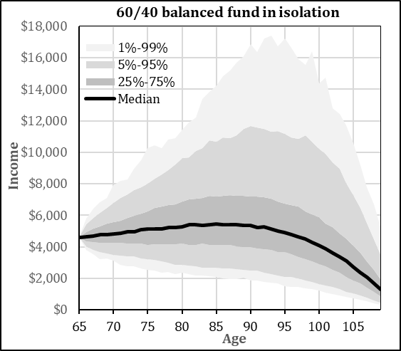
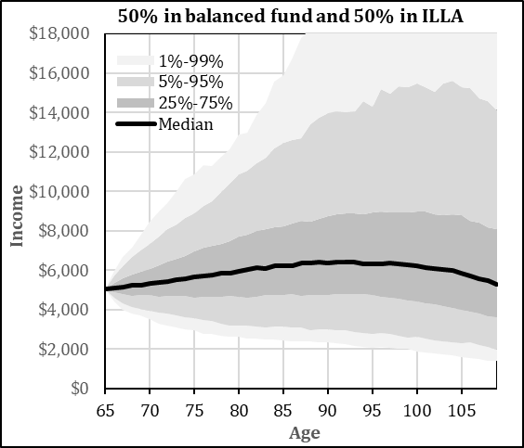
Effect of mortality credits on income
Mortality credits is the source of difference
Their presence supports income that is higher and more sustainable
Of course, purchasers need to survive to capture the entire income stream
ILLA = ‘investment-linked lifetime annuity’. Underlying investments in both cases is a 60/40 balanced fund.
Characterises income from account-based pension and LIS excluding other sources, e.g. Age Pension
DISCUSSION
Looks like a win-win. What is the hitch?

Slide 6
LIS features
Insured vs. pooled – differ in who bears risk and provision cost
Fixed nominal, fixed real or investment-linked
When income commences – immediate or deferred
Access to capital – may come in variety of forms
  Death and exit benefits are common
  Typically limited by Capital Access Schedule (CAS)
Assumed investment return (AIR) – reference rate that shapes income in an ILLA
Fees – may manifest as direct fees, lower income, platform/adviser fees, or insurance premiums
Other – Age Pension impacts; spouse reversionary income; differential pricing; portability
Type of LIS (‘lifetime annuity’) | Acronym
Fixed LIS:
Nominal immediate | LA
Real immediate | RLA
Nominal deferred | DLA
Real deferred | RDLA
Investment-linked | ILLA
DISCUSSION
What features are most important for super funds to offer?

Slide 7


LIS as one component of retirement solutions
Allocation strategy
Investments, e.g. account-based pension (ABP)
Lifetime income streams
Drawdown strategy
Amount drawn from investments to shape up the income stream
integrated
Retirement solution
Conversion of assets into outcomes, in particular income

Slide 8
Use of LIS in retirement solutions – Four themes
Theme | Elements
Type of retiree who may benefit | Willing to trade-off access to some capital for income for life (mortality credits) Likely to be in middle wealth zone, e.g. $300K to > $1 million Other: homeownership; partner situation; bequest motive; desire for certainty
Providing confidence | Comfort of some income for life => encouragement to spend and take more risk Fixed LIS may give more confidence than an ILLA (but latter still helps)
Integrated retirement solutions | Income paid by LIS is secondary, as ABP drawdown shapes up total income Considerations: income post-ABP exhaustion; MDRs; Age Pension impacts Access to capital may be better provided via ABP or contingency account than embedded with LIS (which lowers income stream, and is constrained by CAS)
LIS in an ABP structure | May be useful for super funds to operationally incorporate a LIS in this way
DISCUSSION
Thoughts on how super fund might deal with any of the above?

Slide 9
Overview of available products (as at July 2024)
Distinguishing features | Comments | Positioning of providers
Providers | Only six providers currently More in pipeline, via super funds in particular | For-profit: Allianz, AMP, Challenger, GenLife Super funds: ART, UniSuper
Channels | LIS provided through a mix of direct from provider or fund, via platforms, or through advisers only. TAL (and others) positioning to support funds | Through advisers only: AMP, GenLife Fund direct to member: ART, UniSuper Various channels: Challenger, Allianz
Range of products | Considerable variation in underlying investment options; fixed vs ILLA; and availability of deferred versus immediate LIS. (Examples in next column.) | ILLAs only: AMP, GenLife, ART Fixed (RLA) only: UniSuper Immediate LIS only: GenLife, ART, UniSuper Mix: Challenger, Allianz (variation on product)
Access to capital | Offered by all providers, sometimes optional Fair amount of variation across providers | Allianz only provider offering full access to residual capital; charges insurance premium
Complexity | Products vary in level of complexity Level of complexity and dispersion is of concern | Funds (ART, UniSuper): offer simple products Other providers: products tend to be complex
Insured vs. pooled | For-profit providers all offer insured products Funds are not insured but pooling differs | ART: effectively pooled UniSuper: pools LIS with defined benefit fund

Slide 10
Why the low take-up: Three big issues
Issue | Nature | Solution
1. Lack of understanding | Many retirees are unaware of the existence of LIS When they are aware, they rarely understand the products or their benefits | Education
2. Framing | Often presented and considered as a stand-alone product on a menu, thus inviting narrow framing Typically considered in an ‘investment’ frame rather than in a consumption or insurance frame | Education Care with framing when communicating
3. How LIS are offered | LIS rarely offered as a part of an integrated solution (few funds currently offer solutions containing LIS) Some advisers are reluctant to recommend LIS | Embed LIS within a recommended retirement solution, if not default, i.e. offer as part of ‘hard’ nudge
  – Most retirees do not know of the existence of LIS, and even where they do, they rarely understand the products or their benefits.
DISCUSSION
Do you agree with the above?
Any constraints missing that really matter?

Slide 11
Thoughts on the way forward
  LIS and their potential benefits are not well understood – not only by members, but also much of the super industry
  Some retirees may benefit significantly …. but not all
  Super funds could do a better job at identifying members that would benefit, and firmly suggesting these members consider having a LIS in the mix
  Most super funds first need to develop their LIS offerings!
11
11

Slide 12
Thank-you!
Further questions, discussion or feedback?
Wrapping up …
12

