Slide 1
Retirement explainer #8
Investments in the retirement phase
David Bell – The Conexus Institute
Geoff Warren – The Conexus Institute and ANU

Slide 2
Overview
Three broad areas of discussion:
Role and function of investments within retirement solutions
Investment ‘building blocks’ – possible portfolio types and their nature
Governance and structuring issues for superannuation funds

Slide 3
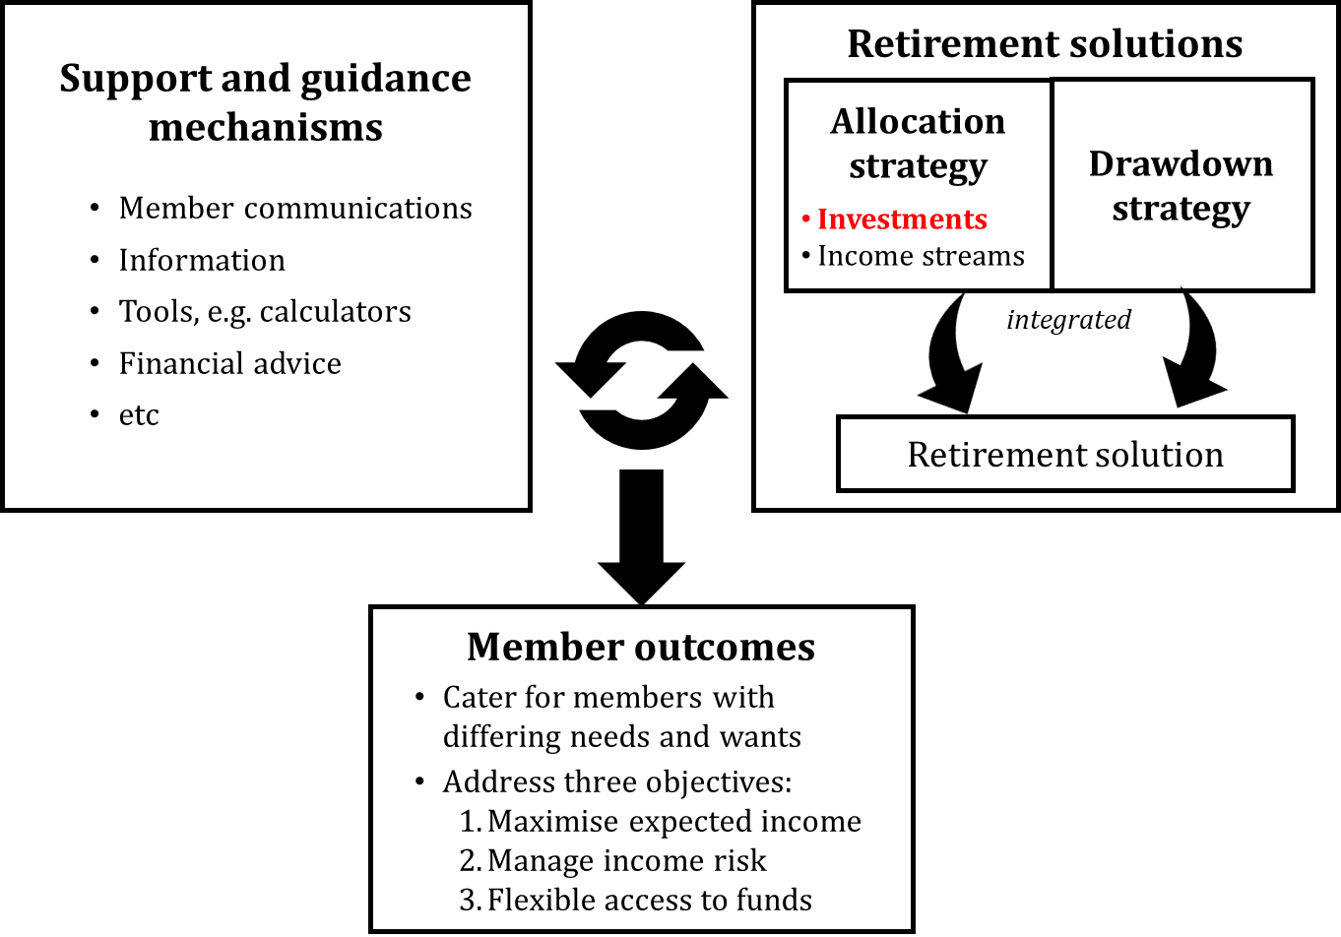
Investments are one component of retirement solutions

Slide 4
Retirement differs from accumulation in key ways
Objectives reframed around member outcomes rather than portfolio outcomes
  Accumulation: Objectives based around returns, e.g. real, relative vs. benchmarks or peers
  Retirement: Objectives are member-focused under the retirement income covenant (RIC)
Retirement brings heightened need to cater for member differences
  Accumulation: All members share a common desire for higher returns (but may vary in the risk they are willing to bear in pursuit of better returns)
  Retirement: Capacity to deliver more personalised solutions is required
Longevity uncertainty enters the frame as an additional key risk to manage
DISCUSSION
Implications for structuring of investments by super funds?

Slide 5
Managing member outcomes vs. pooled portfolios
Member outcomes need to be addressed at member level, but ….
Investment teams are managing pooled portfolios servicing multiple members
This distinction matters for management of:
Liquidity
  Members will be drawing down on their capital, but …
  Pooled portfolios have their own liquidity profile
Risk
  Ideally the retirement solution designer* should take responsibility
  Investment risk should be set given other defensive exposures, e.g. annuities, Age Pension
  Longevity risk also a consideration
  * The ‘designer’ could be retirement function of a super fund, financial adviser, or member themself

Slide 6
Two key functions for the investments
Function | RIC objective | Application
A) Return generation | Income generation: Maximise expected income Manage income risk | Higher growth exposure maximises expected income, but increases income risk Exposures to manage through the investments: Portfolio drawdowns (rather than volatility per se) => manage sequencing risk, member loss aversion Inflation Franking credits Liquidity???
B) Source of accessible funds | Flexible access to funds | Covering spending not covered by regular income: Unanticipated needs, i.e. precautionary savings Bequests Access to aged care Responding to change and opportunities

Slide 7
Potential investment building blocks
Growth portfolio
Defensive portfolio (traditional)
Capital stable portfolio
Balanced portfolios
  Growth + defensive portfolio
  Growth + capital stable portfolio
  Explicitly designed for retirement
  Repurposed from accumulation
Supplied by investment team to be deployed by retirement solution designer (i.e. retirement function, financial adviser, member)
Created by retirement solution designer
Supplied by investment team as ‘pre-mixed’ investment products
DISCUSSION
What set of building blocks make most sense?

Slide 8
Unpacking the building blocks
Building block | Objective / purpose | Considerations
1. Growth portfolio | Maximise long-term compound return to maximise income Manage risk exposures subject to limiting any return sacrifice | Income risk exposure might be addressed through annuities or Age Pension Portfolio drawdown risk might be managed Inflation-hedged assets favoured Franking credits favoured
2. Defensive portfolio (traditional) | Limit overall portfolio risk where beneficial, e.g. address low tolerance for fluctuations in account balance | Nominal long bonds quite exposed to inflation Credit and defensive alternatives might be used ILBs unattractive if return sacrifice is large
3. Capital stable portfolio | Reliable and accessible pot of wealth Aim to avoid reduction in real value of capital over short and long term May seek positive real returns if safe | Prime use: contingency account (rainy day fund) Largely invested in short-duration securities Could be combined with growth portfolio to form a balanced fund
4. Pre-mixed balanced portfolios | May be preferred for reasons of familiarity or efficiency of delivery | Repurposing accumulation options will fail to deliver portfolios tailored to needs of retirees

Slide 9
Fund governance and organisational structure
Issue #2
Shared or segregated portfolios
(A) Shared = same portfolios used for accumulation and retirement
or
(B) Segregated = dedicated portfolios for accumulation and retirement
Issue #1
Responsibility for retirement portfolios
(A) Existing investment team
or
(B1) Dedicated retirement team housed within investment function
or
(B2) Dedicated retirement team housed within retirement function
Issue #3
Performance evaluation … when:
Returns are just one component of member outcomes
Portfolios are tailored for retirees
DISCUSSION
Any thoughts on these issues?

Slide 10
Our final take
  Proposition:
  Retirement portfolios should be supplied as a set of purposefully designed building blocks to support construction of retirement solutions
DISCUSSION
Agree or disagree?

Slide 11
Thank-you!
Further questions, discussion or feedback?
Wrapping up …
11

