Slide 1
Retirement explainer #6:
Pathways to retirement solutions
David Bell – The Conexus Institute
Geoff Warren – The Conexus Institute and ANU

Slide 2
Overview
We investigate various pathways through which retiring or retired members might be directed towards suitable retirement solutions
Our organising structure is who identifies the solution, considering three parties:
  (1) Member (2) Adviser, or (3) Trustee
For each pathway, we outline
  Nature of the pathway
  Strengths and opportunities
  Weaknesses and challenges
  What is required for the pathway to work effectively
We also discuss ‘nudges’

Slide 3
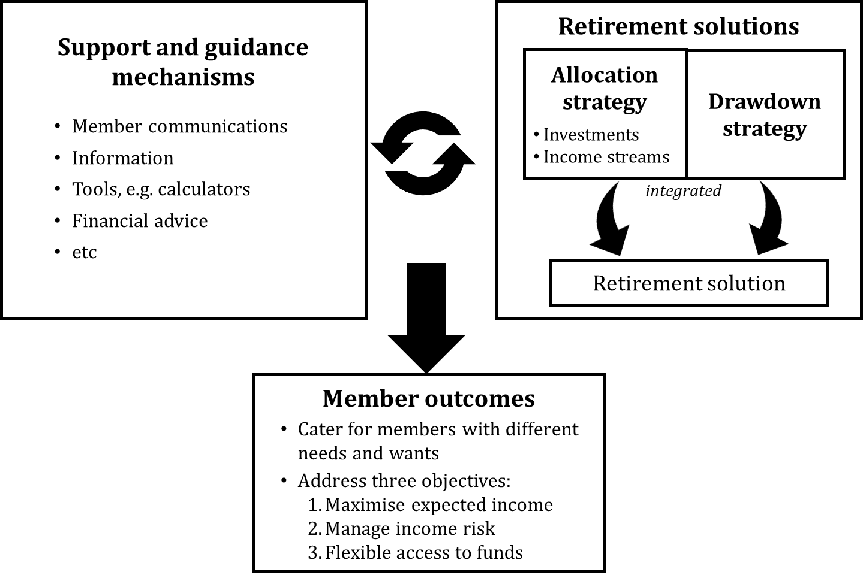
Retirement income strategies vs. solutions
How can retired members find their way to a suitable solution?

Slide 4
Five pathways to retirement solutions

Slide 5
All pathways have a role to play
Members differ in how they want to engage with retirement decisions
Trustee direction is the missing link:
  About 70% of members not taking advice and don’t want to choose
  Some want and expect their fund to look after them
Members may be better off in some pathways than others
DISCUSSION
Does your membership profile look something like this?

Slide 6
Member engagement process
Trustee attempts to triage
Either collects personal information and/or ‘shepherds’ the member
Solution identified (possibly cohort-based); offered with opt-out
Follow-ups … ideally
Please choose one of the following options:
1. Please assign me to a retirement solution | ○
2. Recommend a retirement solution to me | ○
3. Please refer me to a financial planner | ○
4. I want to choose a retirement solution for myself | ○
DISCUSSION
How might the review process work under trustee direction?

Slide 7
Summary – Main opportunities and key challenges
DISCUSSION
Any (major) challenges that are missing?
7

Slide 8
Role for members and trustees – shades of grey
Self-direction | Recommended (‘default’) settings | Recommended (‘default’) solutions for member types | Trustee recommendation of comprehensive solution | Trustee assignment and default
Member Choice | Limited nudges | Firm nudges | Very strong nudge | Forms of default
Member initiates action and makes decision | Trustee directs member in some way |  |  | Trustee assigns member
DISCUSSION
Where should trustees be positioning themselves within the spectrum, in your view?
8

Slide 9
Some takeaways
Members differ in how they engage with retirement decisions. This creates a need for different pathways. Ideally, all pathways would be facilitated and provided.
The trustee direction pathways are currently absent:
  Scalable trustee-directed mechanism needed to cater for ~70% of members, but …
  Trustees cannot collect personal information and use it to direct members to a solution without entering the personal financial advice world
  The Government should facilitate recommendation and/or assignment
  A (hard) default pathway is problematic
Spectrum from self-direction and trustee direction has ‘shades of grey’
9
9

Slide 10
Thank-you!
Further questions, discussion or feedback?
Wrapping up …
For research paper, see:
Conexus Institute website: https://theconexusinstitute.org.au/
Direct link: Pathways-to-retirement-income-solutions-Draft-for-Discussion-Final-20230911.pdf (theconexusinstitute.org.au)
10

