Slide 1
Retirement explainer #1:
Retirement income covenant objectives
David Bell
The Conexus Institute
Geoff Warren
The Conexus Institute and Australian National University

Slide 2
Explainer #1 – What we will cover
Recap on the RIC – What is a retirement income strategy, and its objectives
Interpretation and measurement of each objective:
  Expected income
  Income risk
  Flexible access to funds
Trade-offs
Attaching meaning to the objectives
Questions, discussion, feedback

Slide 3
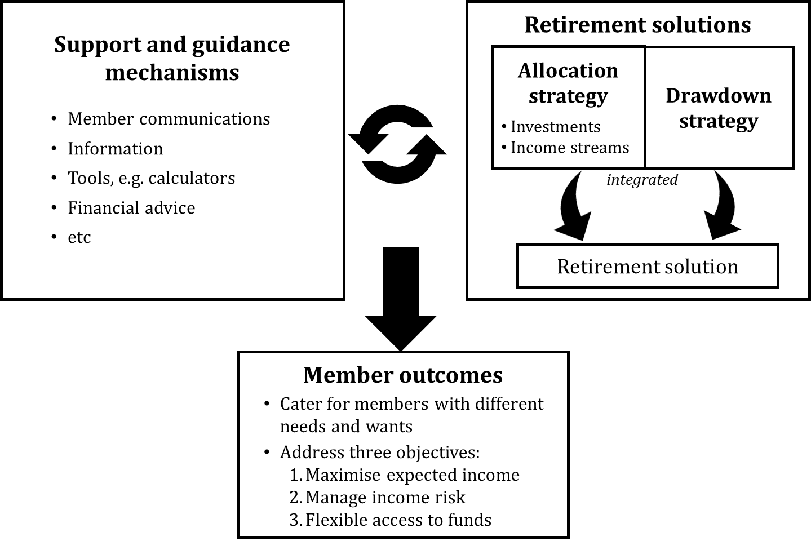
‘Retirement income strategies’
‘Retirement income covenant’ came into effect on 1 July 2022.
The RIC requires super fund trustees to develop retirement income strategies to assist members in balancing three objectives

Slide 4
RIC objectives as they appear in the legislation
“The strategy must be for the benefit of beneficiaries of the entity who are retired or who are approaching retirement and must address how the trustee will assist those beneficiaries to achieve and balance the following objectives:
(a) to maximise expected retirement income over the period of retirement;
(b) to manage expected risks to the sustainability and stability of retirement income over the period of retirement of the following kinds:
(i) longevity risks;
(ii) investment risks;
(iii) inflation risks;
(iv) any other risks to the sustainability and stability of the retirement income;
(c) to have flexible access to expected funds over the period of retirement”

Slide 5
Which income stream has greater expected value?
Basis of measurement:
DISCUSSION
Which measure should be used?
Any of these? Anything else?
5

Slide 6
Expected income - another complication
DISCUSSION
How should super fund trustees be defining member “income” when designing retirement solutions?
6

Slide 7
Which income stream is riskier?
DISCUSSION
Which is more sustainable
Which is more stable?
Income percentiles for 60/40 account-based pension under two drawdown strategies
7

Slide 8
Income risk drivers
The RIC mentions the following:
(i) longevity risks
(ii) investment risks
(iii) inflation risks
(iv) any other risks
DISCUSSION
How might these drivers be taken into account in managing income risk?
8

Slide 9
Flexible access to funds
Possible motivations for flexible access to funds:
(i) Meeting unexpected needs
(ii) Aged care
(iii) Bequests
(iv) Respond to change or opportunity
DISCUSSION
How might fund trustees cater for these desires?
9

Slide 10
Re-considering through the lens of trade-offs
Choice | Benefit | Cost
Reduce income being drawn | Income more likely to last to an old age Retains more accessible funds | Expected income lowered Increased risk of regret of not enjoying savings
Allow income to vary with balance; reduce with poor returns | Income more sustainable as balance is not being quickly exhausted Helps retain some accessible funds | Income will vary from year-to-year
Buy an inflation-linked annuity | Income purchased is sustainable Income purchased is stable | Lower expected income than if exposed to growth assets Most annuities give up some access to funds
10

Slide 11
Giving meaning to the RIC objectives
Trade-offs in previous slide hint at how to give meaning to the RIC objectives … link them to member needs and wants
Consider a member who desires:
  Stable income stream while they remain alive
  Some flexible access to funds
Translating to RIC objectives:
  Expected income => linked to income targeted
  Income risk => probability of targeted income not being sustained
  Flexible access to funds => examine trajectory of residual balance
DISCUSSION
How might fund trustees cater for these desires?
(Is personal advice the only way?)
11

Slide 12
Thank-you!
Further questions, discussion or feedback?
Wrapping up …
12

